Slide 1
SALARY PREDICTION ANALYSIS
GAYATHIRI N

Slide 2
INTRODUCTION
In the ever-evolving job market, accurately predicting salaries is crucial for various aspects of workforce management, recruitment, and financial planning. Estimating salaries based on diverse factors allows organizations to make well-informed decisions regarding budget distribution, employee remuneration, and talent acquisition strategies. Consequently, the development of robust salary prediction models has become highly valuable in contemporary business operations.
The objective of our project is to build a dependable salary prediction system that utilizes machine learning techniques to forecast salaries for individuals based on key attributes such as job title, job category, and work location. By analyzing historical salary data and identifying patterns within the job market, our aim is to develop a model capable of producing precise salary estimates for new job listings or evaluating the competitiveness of compensation packages offered by employers.
Through this project, we intend to tackle several key challenges in salary prediction, including the inherent variability in compensation across different industries, regions, and job roles, as well as the intricate interplay of factors influencing salary determination. By applying advanced machine learning algorithms and feature engineering techniques to large-scale datasets, we aspire to create a predictive model that not only achieves high accuracy but also provides insights into the factors driving salary disparities and trends within the job market.
Ultimately, our salary prediction project aims to empower businesses, recruiters, and job seekers with actionable insights into salary expectations. This, in turn, facilitates more transparent and equitable negotiations, optimizes resource allocation, and supports informed decision-making in the realm of human resource management

Slide 3
OBJECTIVE
In the modern job market, accurately predicting salaries for various positions is crucial for organizations to make strategic decisions about budget allocation, compensation structures, and talent acquisition. However, predicting salaries involves multiple challenges due to the complexity of salary determinants and the variability within the job market.
Our primary objective with this salary prediction project is to accurately estimate salaries based on critical attributes such as job title, job category, and work location and various other as well. This requires us to consider the intricate interactions between these factors and their influence on salary levels across different roles and titles.
Additionally, the project must address the challenges associated with the quality and availability of data for salary prediction, which can vary widely. This includes dealing with data preprocessing, selecting relevant features, and ensuring the model can generalize well. Factors such as hours/shift, Full-time/Part time indicator and skills also introduce temporal variability that must be incorporated into the prediction model.
By creating a robust salary prediction model, we aim to overcome these obstacles and provide stakeholders with a dependable tool for estimating salaries with high accuracy. This model will help organizations refine their recruitment and compensation strategies while also enabling job seekers to negotiate fair and competitive salaries based on their qualifications and current market trends.
Ultimately, our salary prediction project aspires to bridge the gap between employer expectations and candidate aspirations by using advanced machine learning techniques to offer transparent and data-driven salary estimates. This will promote more equitable negotiations and support informed decision-making in human resource management.

Slide 4
DATASET OVERVIEW
Dataset Name : “Jobs_NYC_Postings.csv”
Dataset Description : This dataset includes comprehensive information regarding job postings in NYC. Key attributes in the dataset include Agency, Title, Job Category, Skills Preferred, Number of Postings, Work Location and other relevant details
Target = Salary Range (from and To)
This dataset will be used to develop our salary prediction model by leveraging the various attributes to accurately forecast the salary ranges for different job postings.

Slide 5
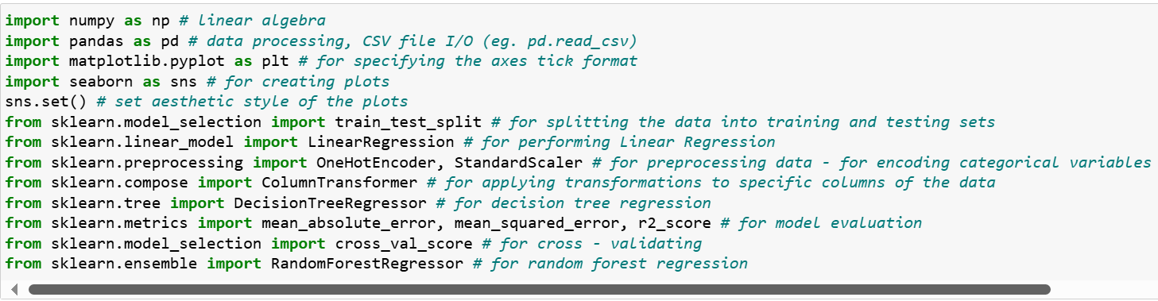
LIBRARIES USED
Pandas = For Dataframe Operations
Numpy = For Numeric Operations
Matplotlib And Seaborn = For Visualizations
Sklearn = To implement ML Models and Statistical Modelling

Slide 6
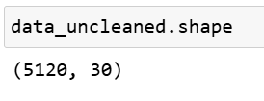
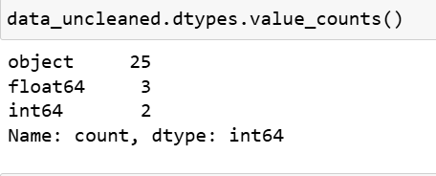
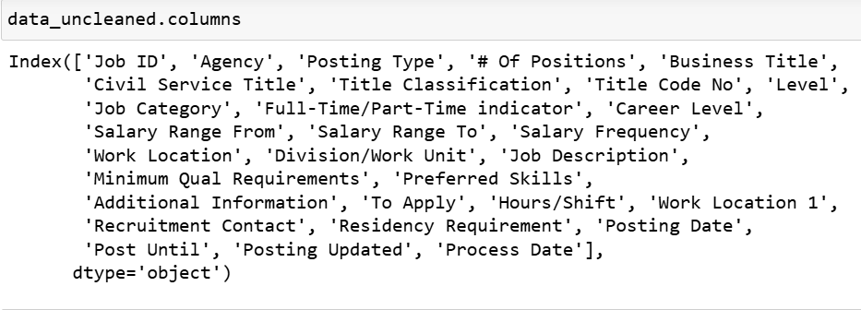
GETTING TO KNOW THE DATA

Slide 7
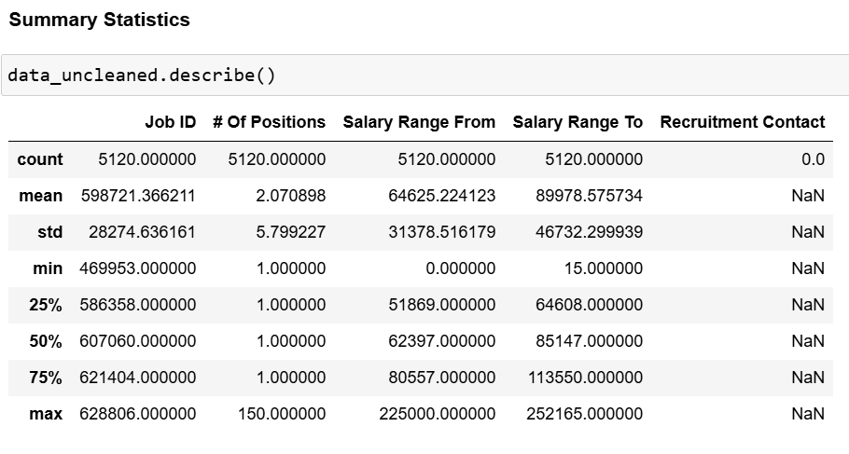
SUMMARY STATISTICS

Slide 8
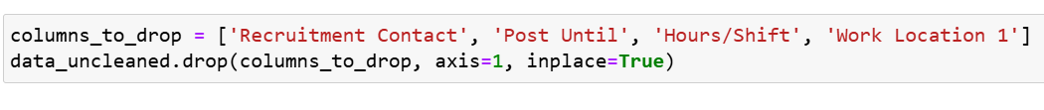
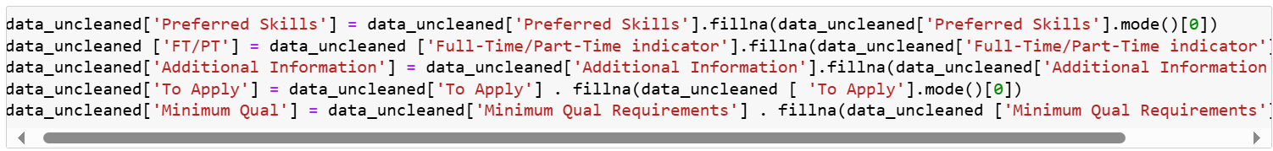
HANDLING MISSING VALUES
We drop few columns and handle few columns statistically
Filling Missing Data Statistically – using Mode

Slide 9
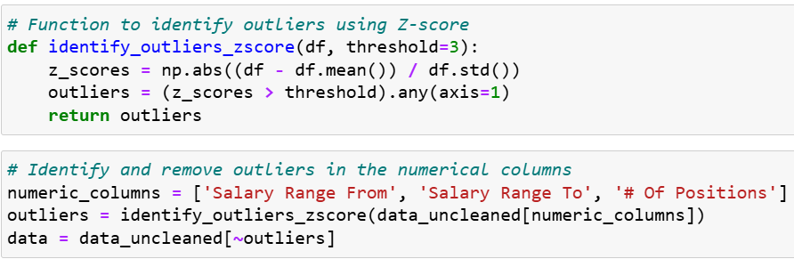
HANDLING OUTLIERS

Slide 10
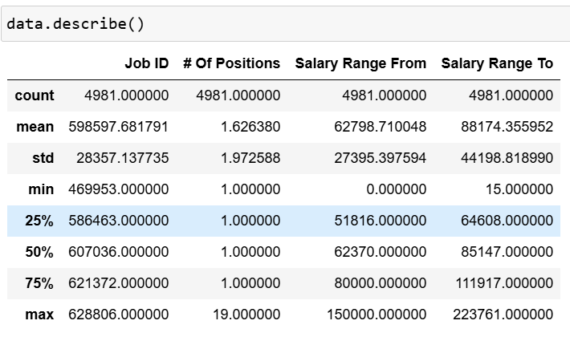
SUMMARY STATISTICS AFTER HANDLING OUTLIERS

Slide 11
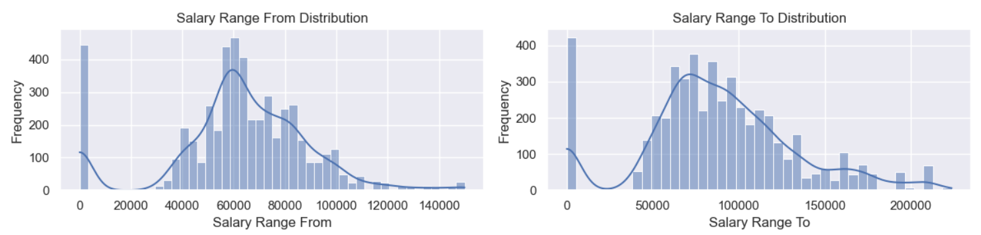
VISUALIZATIONS
HISTOGRAM

Slide 12
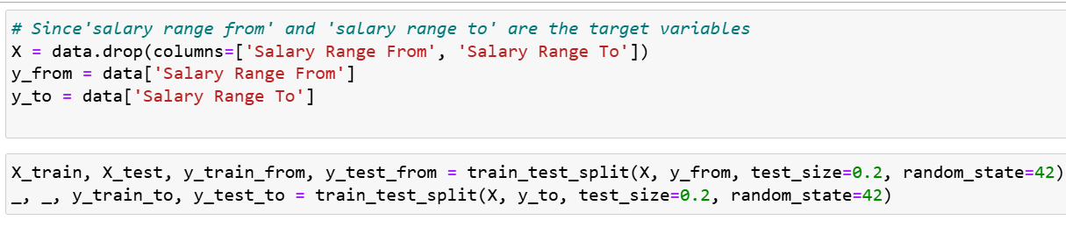
TRAIN TEST SPLIT

Slide 13
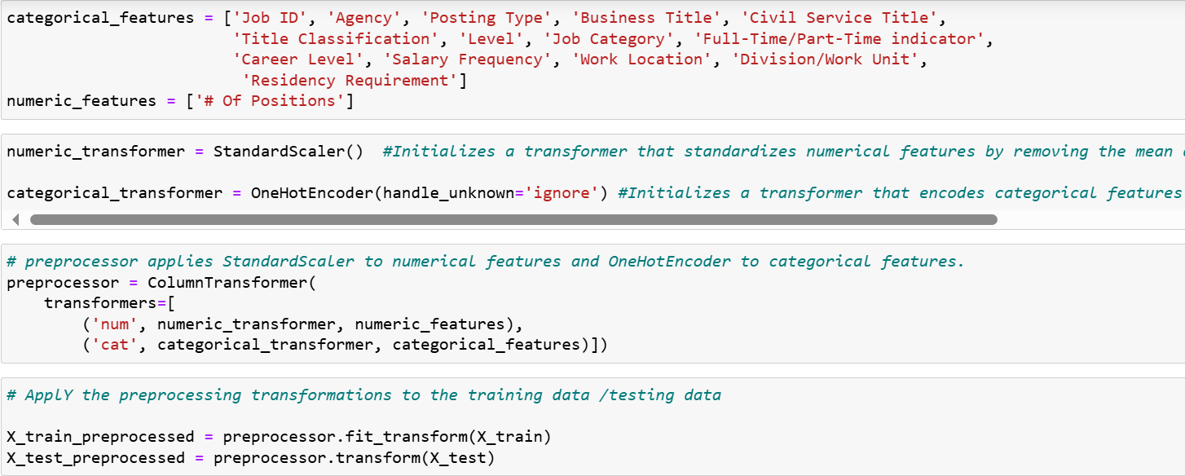
DATA TRANSFORMATION

Slide 14
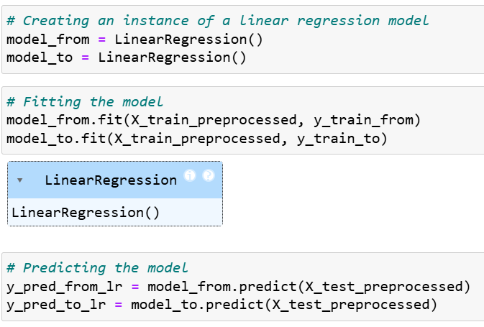
SIMPLE LINEAR REGRESSION

Slide 15
SIMPLE LINEAR REGRESSION METRICS
RMSE :
RMSE for Salary Range From (Simple Linear Regression): 4269.33
RMSE for Salary Range To (Simple Linear Regression): 6649.65
MAE :
MAE for Salary Range From (LR): 1359.62
MAE for Salary Range To (LR): 2311.74
R2 :
R^2 Score for Salary Range From (LR): 0.98
R^2 Score for Salary Range To (LR): 0.98
Cross Validation:
Cross-Validated RMSE for Linear Regression (Salary Range From): 6567.024425878359
Cross-Validated RMSE for Salary Range To (Linear Regression): 9144.56453913518

Slide 16
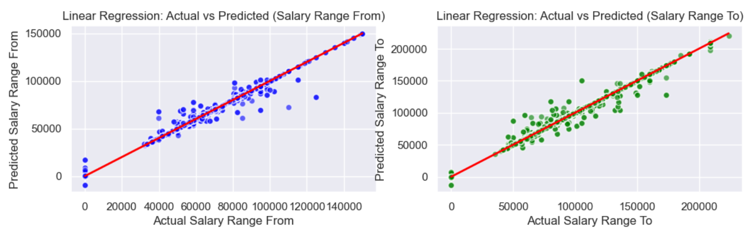
ACTUAL VS PREDICTED

Slide 17
SUMMARY – ACTUAL VS PREDICTED
The linear regression model used to predict both "Salary Range From" and "Salary Range To" shows a decent fit, with the actual values closely aligning with the predicted values.
Both scatter plots indicate that while the model is not perfect (there is some spread of points around the red line), it generally makes accurate predictions.
The red line in both plots helps visualize how well the model's predictions align with the actual values, and in both cases, the points are clustered around this line, indicating a good model performance.

Slide 18
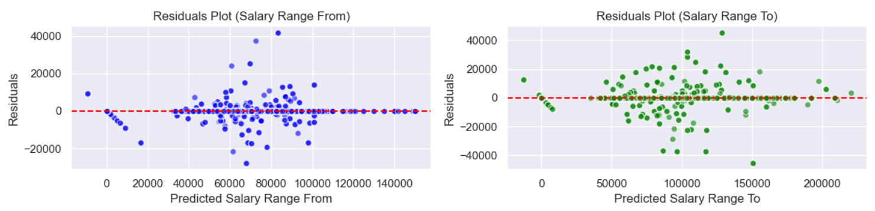
RESIDUAL PLOTS

Slide 19
SUMMARY – RESIDUAL PLOTS
The residuals for both salary ranges are centered around zero, which is good in a well-fitted linear regression model.
The lack of a clear pattern in the residual plots indicates that the linear regression model is appropriately specified (i.e., the model does not show clear signs of misspecification like non-linearity or heteroscedasticity).

Slide 20
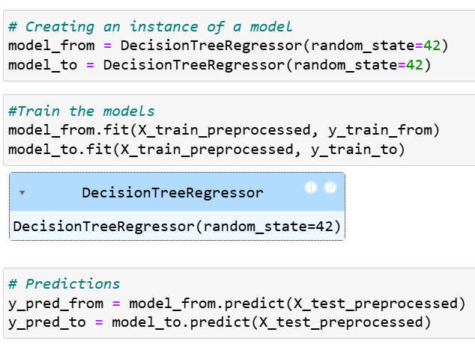
DECISION TREES

Slide 21
DECISION TREE METRICS
RMSE:
RMSE for Salary Range From (Decision Tree): 4792.79
RMSE for Salary Range To (Decision Tree): 7589.90
MAE :
MAE for Salary Range From: 1094.89
MAE for Salary Range To: 2224.43
R^2:
R^2 Score for Salary Range From: 0.97
R^2 Score for Salary Range To: 0.97
Cross-Validation:
Cross-Validated RMSE for Decision Tree (Salary Range From): 7450.486766262601
Cross-Validated RMSE for Decision Tree (Salary Range To): 10998.693418451465

Slide 22
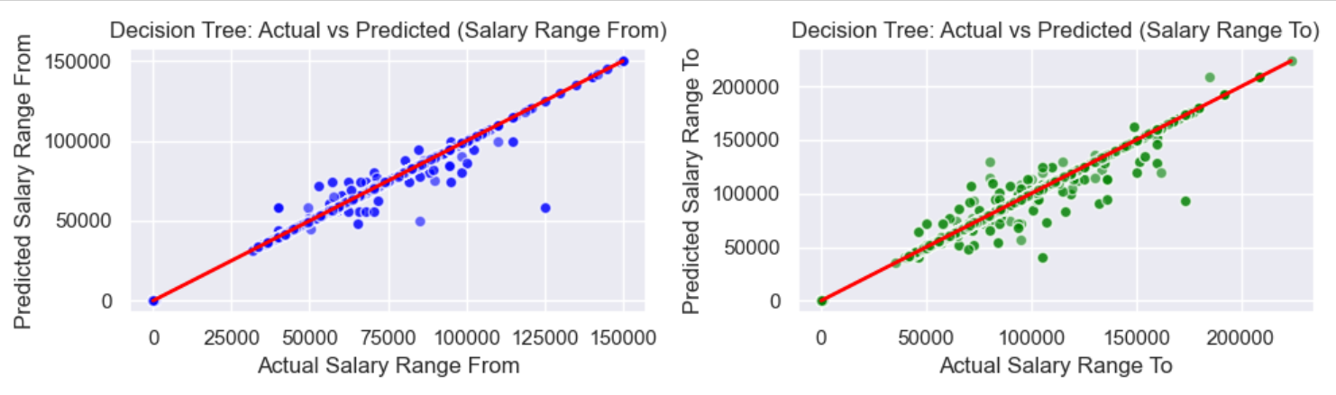
ACTUAL VS PREDICTED

Slide 23
SUMMARY – ACTUAL VS PREDICTED
The Decision Tree model used to predict both "Salary Range From" and "Salary Range To" shows a good fit, with the actual values closely aligning with the predicted values.
Both scatter plots indicate that while the model is not perfect (there are some deviations), it generally makes accurate predictions.
The red line in both plots helps visualize how well the model's predictions align with the actual values. In both cases, the points are clustered around this line, indicating good model performance.

Slide 24
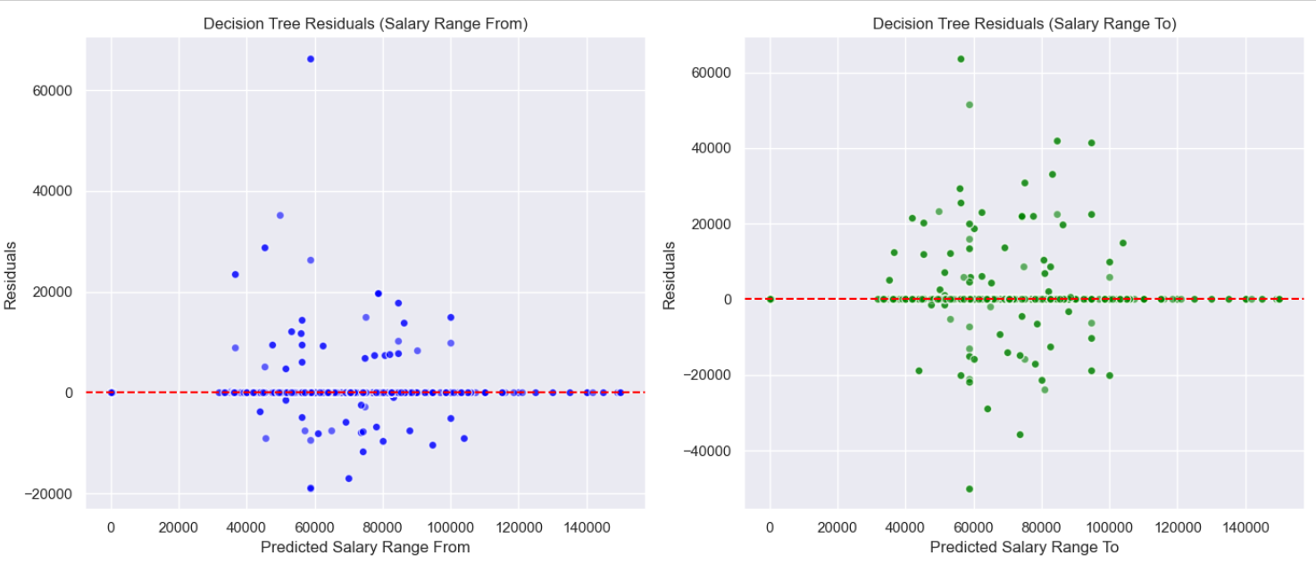
RESIDUAL PLOTS

Slide 25
SUMMARY – RESIDUAL PLOTS
The residuals for both salary ranges are centered around zero, which is good in a well-fitted linear regression model.
The lack of a clear pattern in the residual plots indicates that the Decision Tree model is appropriately specified (i.e., the model does not show clear signs of misspecification like non-linearity or heteroscedasticity).

Slide 26
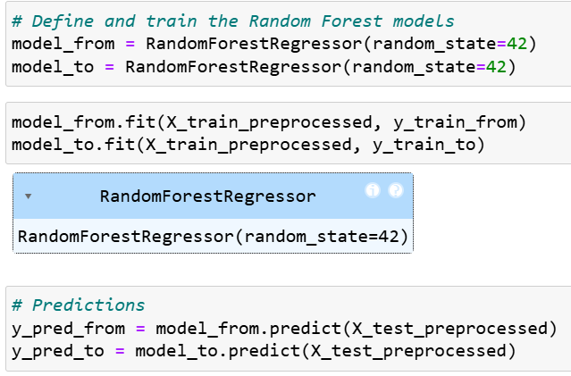
RANDOM FOREST

Slide 27
RANDOM FOREST METRICS
RMSE:
RMSE for Salary Range From (Random Forest): 6032.76
RMSE for Salary Range To (Random Forest): 9455.18
MAE:
MAE for Salary Range From: 2706.35
MAE for Salary Range To: 5128.31
R^2:
R^2 Score for Salary Range From: 0.95
R^2 Score for Salary Range To: 0.95
Cross-Validation:
Cross-Validated RMSE for Random Forest (Salary Range From): 7467.52731817686
Cross-Validated RMSE for Random Forest (Salary Range To): 10988.70886270945

Slide 28
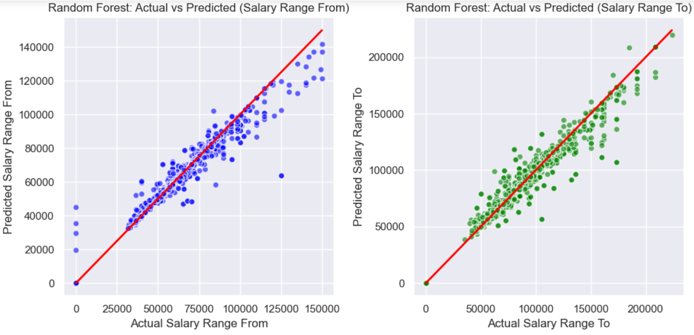
ACTUAL VS PREDICTED

Slide 29
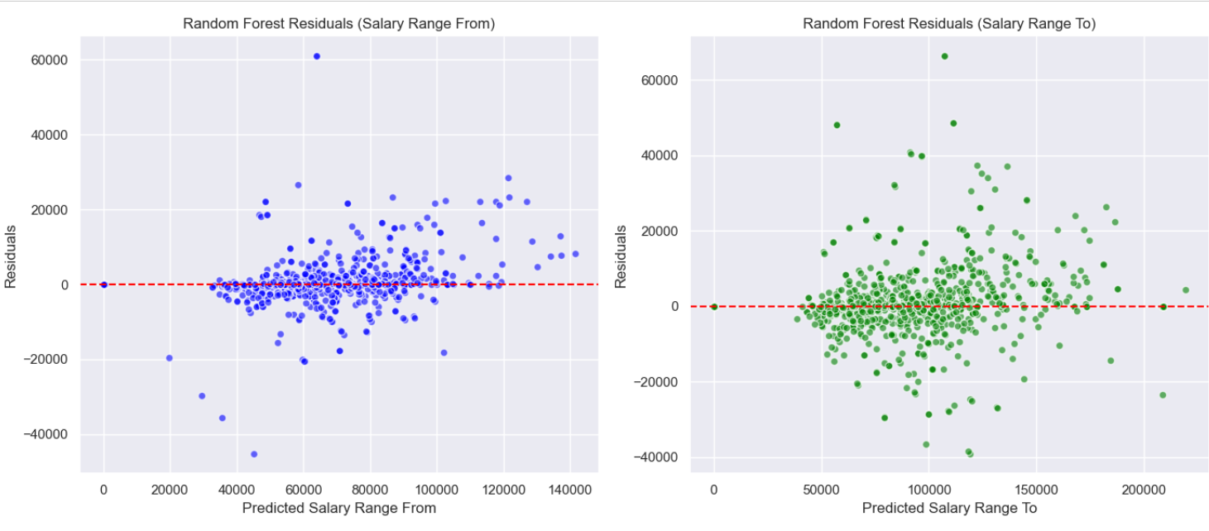
RESIDUAL PLOTS

Slide 30
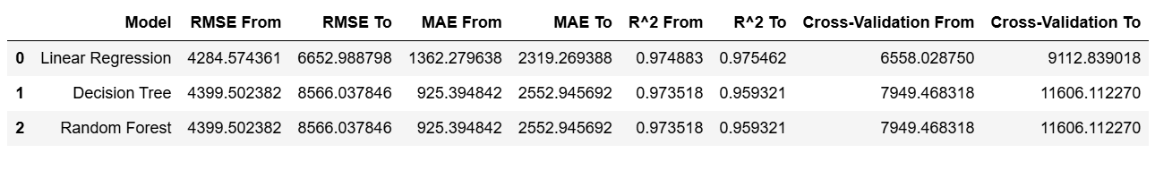
MODEL COMPARISON

Slide 31
CONCLUSION
RMSE (Root Mean Square Error):
Linear Regression has the lowest RMSE range (4269.334430 to 6649.645118), suggesting it provides the most accurate predictions in terms of minimizing overall prediction errors.
Decision Tree and Random Forest have higher RMSE ranges, indicating they produce more significant prediction errors compared to Linear Regression.
MAE (Mean Absolute Error):
Linear Regression has a slightly higher MAE range (1359.623616 to 2311.740721) compared to Decision Tree (1094.889579 to 2224.426698).
This indicates that on average, the Decision Tree model's predictions are slightly closer to the actual values. Random Forest has the highest MAE range, showing that it has the highest average prediction error among the three models.
R² (Coefficient of Determination):
Linear Regression shows the highest R² range (0.975062 to 0.975486), indicating it explains the highest proportion of the variance in the target variable.
Decision Tree and Random Forest have slightly lower R² ranges, suggesting they explain slightly less variance in the data.
Cross-Validation:
Linear Regression has the lowest range for cross-validation errors (6567.024426 to 9144.564539), which implies it performs more consistently across different subsets of the data.
Decision Tree and Random Forest have higher cross-validation error ranges, indicating less stability and consistency compared to Linear Regression.

Slide 32
Conclusion: Based on the performance metrics:
Linear Regression stands out as the best model for predicting salary. It has the lowest RMSE and highest R² values, indicating it provides the most accurate and consistent predictions with the highest explanatory power for the variance in the target variable.
Although the Decision Tree model has a slightly lower MAE, its higher RMSE and lower R² values compared to Linear Regression suggest it is less effective in terms of overall predictive performance.
The Random Forest model, despite being a more complex ensemble method, shows higher errors (both RMSE and MAE) and lower R² compared to Linear Regression, indicating it is less suitable for this particular problem.
Therefore, Simple Linear Regression is the recommended model due to its superior performance in minimizing prediction errors and explaining variance in the target variable.

